Slide 1
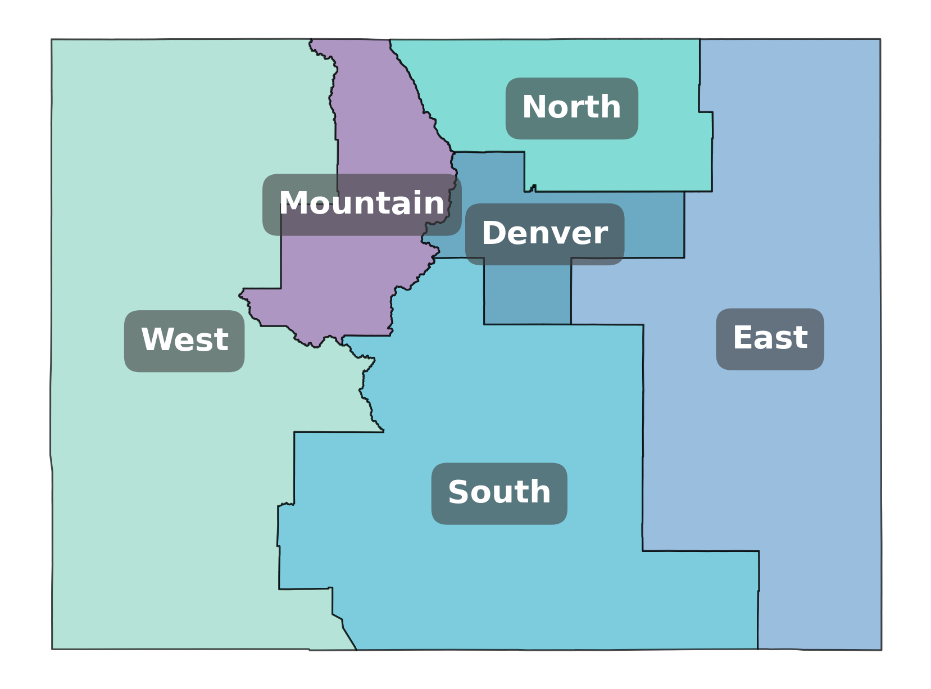
Wyoming
Nebraska
Eastern Interconnect
Utah
Four Corners
New Mexico

